Slide 1
Introduction to LaTeX
Jon Sporring
Department of Computer Science
2020/08/30

Slide 2
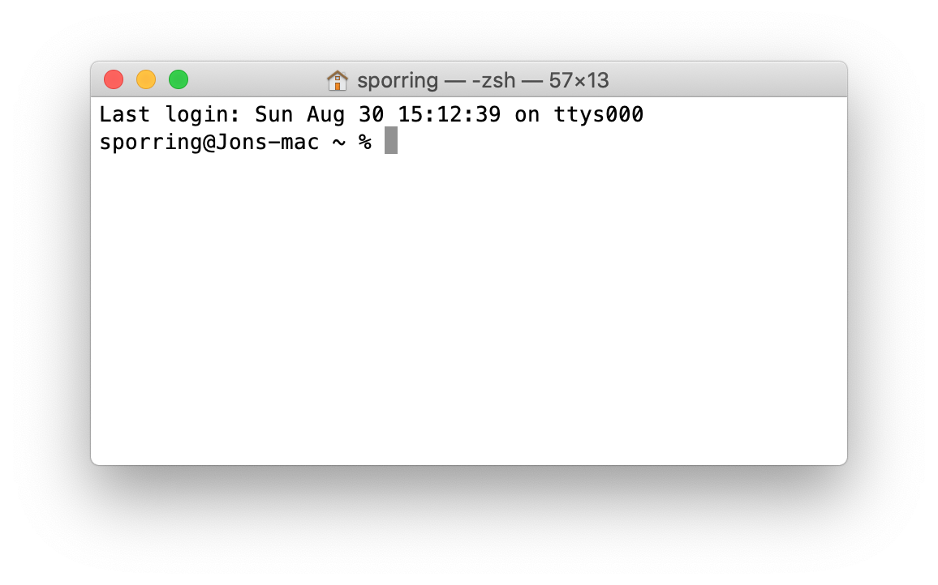
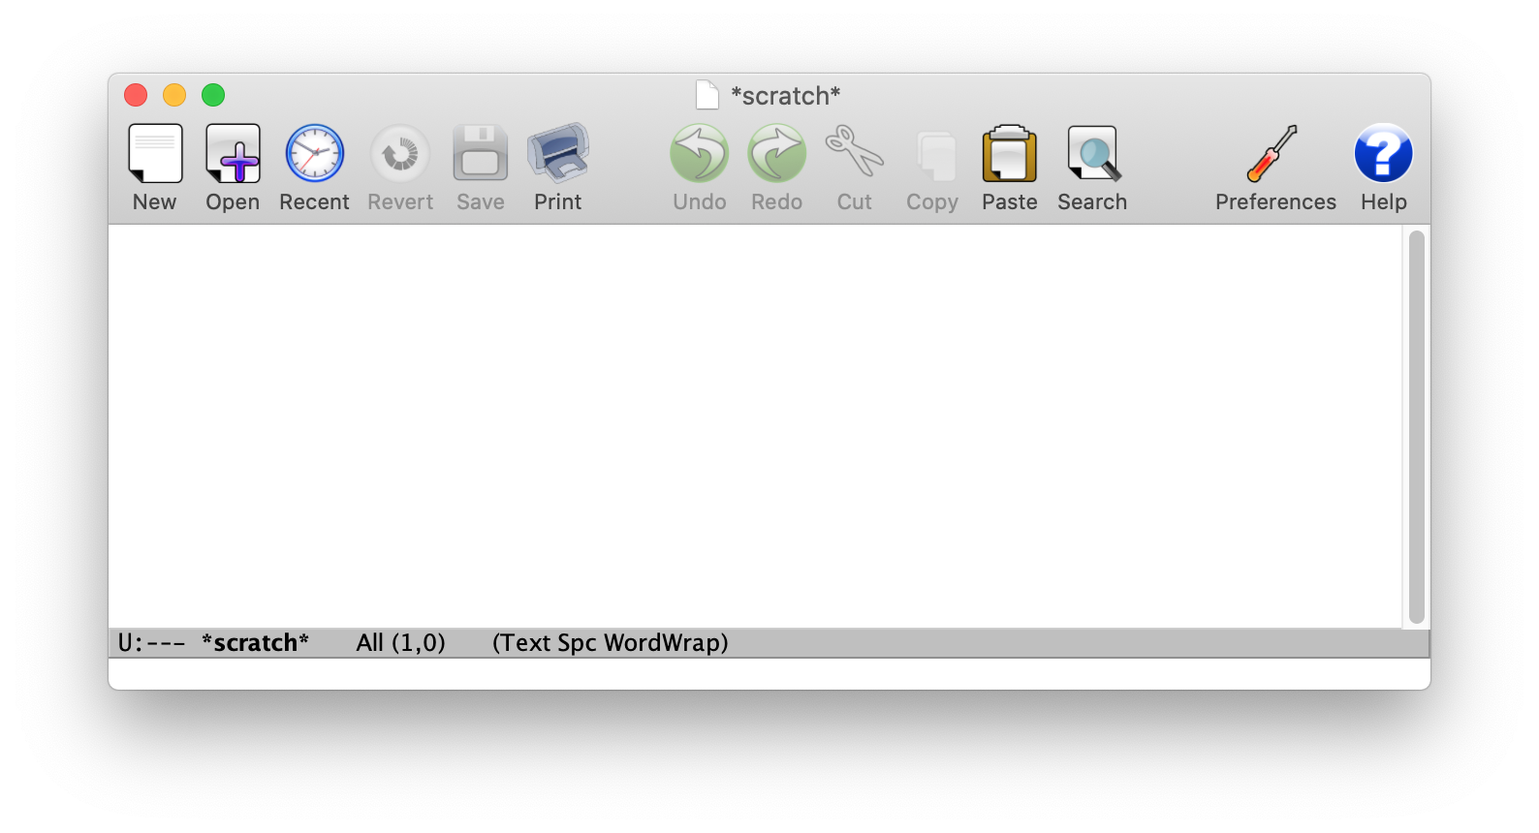

0. Content of this video
Introduction to the command line
Introduction to Emacs
Introduction to LaTeX

Slide 3
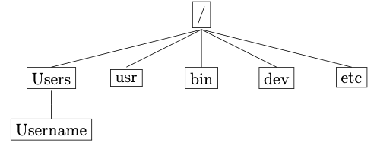
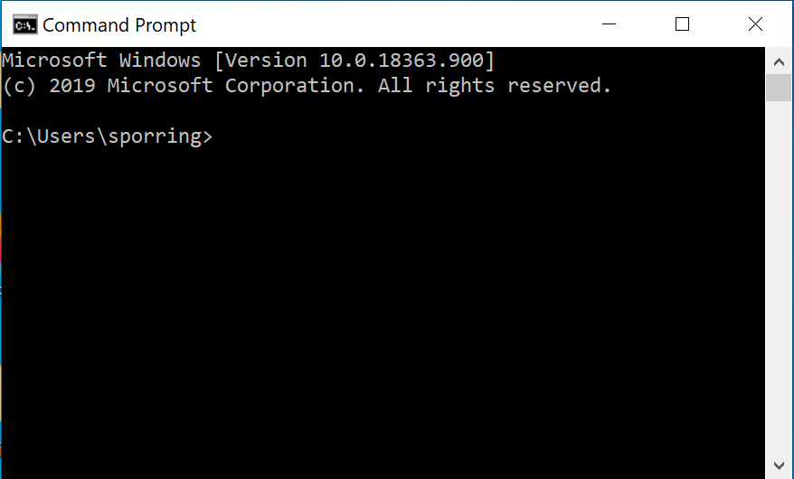
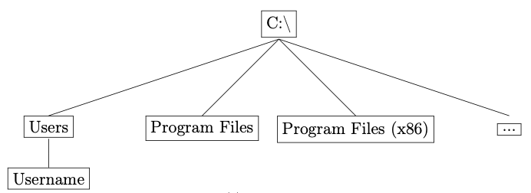
1. Command line
The filesystem
Command line (Windows) vs. Terminal (MacOS/Linux)

Slide 4
2. Introduction to Emacs
Emacs (Editor Macros) is a family of text editors.
Used to be text-only, now many have graphical user interfaces
Greatly extendable and programmable.

Slide 5
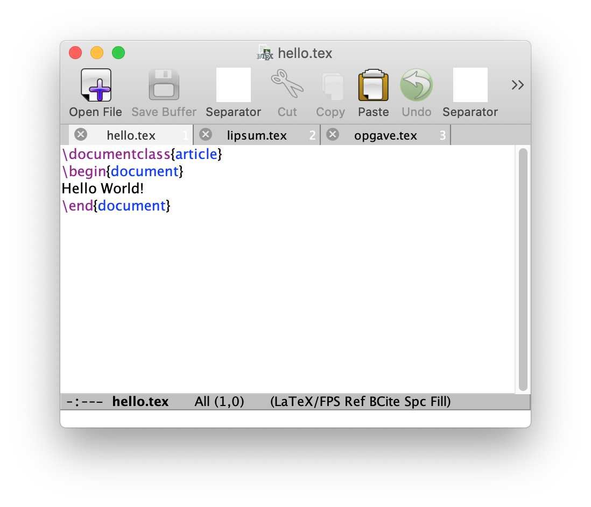
3. Introduction to LaTeX
LaTeX, a system for preparing documents, Leslie Lamport, 1984

Slide 6
Summary
Command line
Text editor
LaTeX

